Slide 1

18CSC202J - OBJECT ORIENTED DESIGN AND PROGRAMMING
Session 6
Topic :Exceptional Handling: try and catch, multilevel exceptional

Slide 2
Exceptions
Indicate problems that occur during a program’s execution
Occur infrequently
Exceptions provide a way to transfer control from one part of a program to another.
A C++ exception is a response to an exceptional circumstance that arises while a program is running, such as an attempt to divide by zero.

Slide 3
Exception handling
Can resolve exceptions
Allow a program to continue executing or
Notify the user of the problem and
Terminate the program in a controlled manner
Makes programs robust and fault-tolerant
Types
Synchronous exception (out-of-range index, overflow)
Asynchronous exception (keyboard interrupts)

Slide 4
Types of Exception
Two types of exception:
Synchronous Exceptions
Asynchronous Exceptions

Slide 5
Synchronous Exceptions
Occur during the program execution due to some fault in the input data or technique that is not suitable to handle the current class of data, within the program .
For example:
errors such as out of range
Overflow
underflow and so on

Slide 6
Asynchronous Exceptions
Caused by events or faults unrelated (external) to the program and beyond the control of the program.
For example
errors such as keyboard interrupts
hardware malfunctions
disk failure and so on
The exception handling mechanism of C++ is designed to handle only synchronous exceptions within a program.

Slide 7
Exception levels
Exceptions can occur at many levels:
Hardware/operating system level.
• Arithmetic exceptions; divide by 0.
• Memory access violations; stack over/underflow.
Language level.
• Type conversion; illegal values, improper casts.
• Bounds violations; illegal array indices.
• Bad references; null pointers.
3. Program level.
• User defined exceptions.

Slide 8
Need of Exceptions
Detect and report an “exceptional circumstance”
Separation of error handling code from normal code
Functions/ Methods can handle any exception they choose
Grouping of Error types

Slide 9
Mechanism
Find the problem (Hit the exception)
Inform that an error has occurred (Throw the exception)
Receive the error information (Catch the exception)
Take corrective actions (Handle the exception)

Slide 10
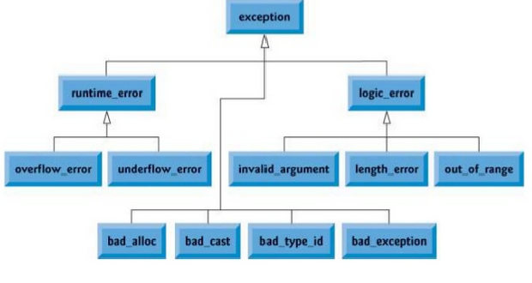
C++ Standard Exceptions

Slide 11
C++ Standard Exceptions
Exception | Description
std::exception | An exception and parent class of all the standard C++ exceptions.
std::bad_alloc | This can be thrown by new.
std::bad_cast | This can be thrown by dynamic_cast.
std::bad_exception | This is useful device to handle unexpected exceptions in a C++ program
std::bad_typeid | This can be thrown by typeid.

Slide 12
C++ Standard Exceptions
Exception | Description
std::logic_error | An exception that theoretically can be detected by reading the code.
std::domain_error | This is an exception thrown when a mathematically invalid domain is used
std::invalid_argument | This is thrown due to invalid arguments.
std::length_error | This is thrown when a too big std::string is created
std::out_of_range | This can be thrown by the at method from for example a std::vector and std::bitset<>::operator[]().

Slide 13
C++ Standard Exceptions
Exception | Description
std::runtime_error | An exception that theoretically can not be detected by reading the code.
std::overflow_error | This is thrown if a mathematical overflow occurs.
std::range_error | This is occured when you try to store a value which is out of range.
std::underflow_error | This is thrown if a mathematical underflow occurs.

Slide 14
Exceptions: keywords
Handling the Exception is nothing but converting system error message into user friendly error message
Exception handling use three keywords for handling the exception
try
catch
throw

Slide 15
Simple Exceptions : syntax
……..
………
try
{
………
throw exception;
………
………
}
catch(type arg)
{
……….
………..
}
…….
…….

Slide 16
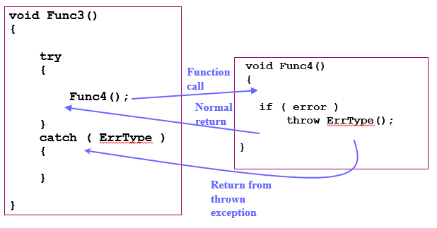
Exceptions

Slide 17
Simple Exceptions : Example
#include<iostream>
using namespace std;
int main()
{
int a,b;
cin >> a>> b;
try
{
if (b!=0)
{
cout<<“result (a/b)=”<<a/b;
}
else
{
throw(b);
}
}
catch(int i)
{
cout <<“exception caught”;
}
}

Slide 18
Nested try blocks
try
{
……..
try
{
………
}
catch (type arg)
{
………
}
}
catch(type arg)
{
……….
………..
}

Slide 19
Multiple Catch Exception
Used when a user wants to handle different exceptions differently.
For this, a user must include catch statements with different declaration.

Slide 20
Multiple Catch Exception
It is possible to design a separate catch block for each kind of exception
Single catch statement that catches all kind of exceptions
Syntax
catch(…)
{
…….
}
Note :
A better way to use this as a default statement along with other catch statement so that it can catch all those exception which are not handle by other catch statement

Slide 21
Multiple catch statement : Syntax
try
{
……..
}
catch (type1 arg)
{
………
}
catch (type2 arg)
{
………
}
……..
catch(typeN arg)
{
………..
}

Slide 22
Multiple Exceptions : Example
#include<iostream>
using namespace std;
int main()
{
int a,b;
cin >> a>> b;
try
{
if (b!=a)
{
float div = (float) a/b;
if(div <0)
throw ‘e’;
cout<<div;
}
else
throw b;
}
catch(int i)
{cout <<“exception caught”;
}
catch(int i)
{
cout <<“exception caught : Division by zero”;
}
catch (char st)
{
cout << “exception caught : Division is less than 1”;
}
catch(…)
{
cout << “Exception : unknown”;
}
}

Slide 23
Bad Exception: Example
std::cerr:-
Standard output stream for errors
Object of class ostream that represents the standard error stream oriented to narrow characters (of type char). It corresponds to the C stream stderr.
The standard error stream is a destination of characters determined by the environment. This destination may be shared by more than one standard object (such as cout or clog).
The object is declared in header <iostream> with external linkage and static duration: it lasts the entire duration of the program.

Slide 24
// bad_exception example
#include <iostream> // std::cerr
#include <exception> // std::bad_exception, std::set_unexpected
void myunexpected () {
std::cerr << "unexpected handler called\n";
throw;
}
void myfunction () throw (int,std::bad_exception) {
throw 'x'; // throws char (not in exception-specification)
}
int main (void) {
std::set_unexpected (myunexpected);
try {
myfunction();
}
catch (int) { std::cerr << "caught int\n"; }
catch (std::bad_exception be) { std::cerr << "caught bad_exception\n"; }
catch (...) { std::cerr << "caught some other exception\n"; }
return 0;
}
Output:-
Unexpected handler called
Caught bad exception

Slide 25
Bad Allocation: Example
Type of the exceptions thrown by the standard definitions of operator new and operator new[] when they fail to allocate the requested storage space.
This class is derived from exception. See the exception class for the member definitions of standard exceptions.
Its member what returns a null-terminated character sequence identifying the exception.

Slide 26
#include <iostream>
#include <new>
int main () {
try
{
int * myarray = new int[1000000000000];
}
catch (std::bad_alloc & exception)
{
std::cerr << "bad_alloc detected: " << exception.what();
}
return 0;
}

Slide 27
https://www.sololearn.com/Play/CPlusPlus
https://www.hackerrank.com/domains/cpp

